Slide 1
初探 Go-WebAssembly
David Chang
DevOps@mithril

Slide 2
What is WebAssembly

Slide 3

WebAssembly
A new language for web
Compiled from other languages
Offers maximized, reliable performance
Not replacing JS

Slide 4
A new language for web
A low level language
standard
a binary instruction and a assembly-like format
Supported by Mozilla, Google, Microsoft, Apple

Slide 5
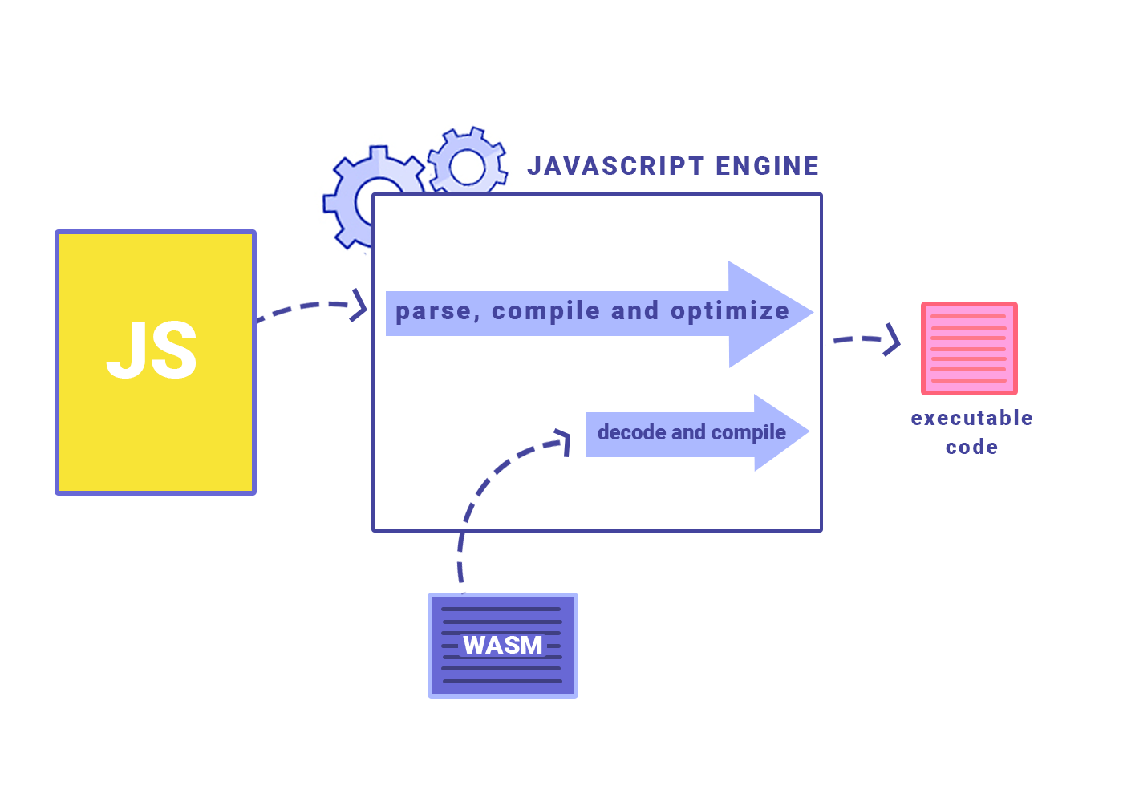
WebAssembly Now
Release 1.0 (Draft, last updated Dec 13, 2018)
Experimental
Notes:
Runs in javascript engines

Slide 6
Why WebAssembly
What’s wrong with JS?

Slide 7

Web Javascript
Slow
Insecure
Dynamic type vs static type
Avoid heavy computing in Front-End
Easy-writing
Huge eco-system
Notes:
Slow: type assertion, parse, execute, requires lots of optimization
Insecure: memory control

Slide 8


Historical Javascript
ECMAScript -> by Brendan Eich in late 1995
Internet Explorer 3
NodeJS -> 2009
npm -> 2010
Notes:
Designed for web

Slide 9



JS is getting faster
Just In Time compiler of JS engine
trace and re-optimize (loop)
GC
Built-in functions / Stadard Library / APIs
Notes:
Slow: type assertion, parse, execute, requires lots of optimization

Slide 10
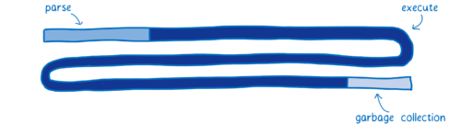
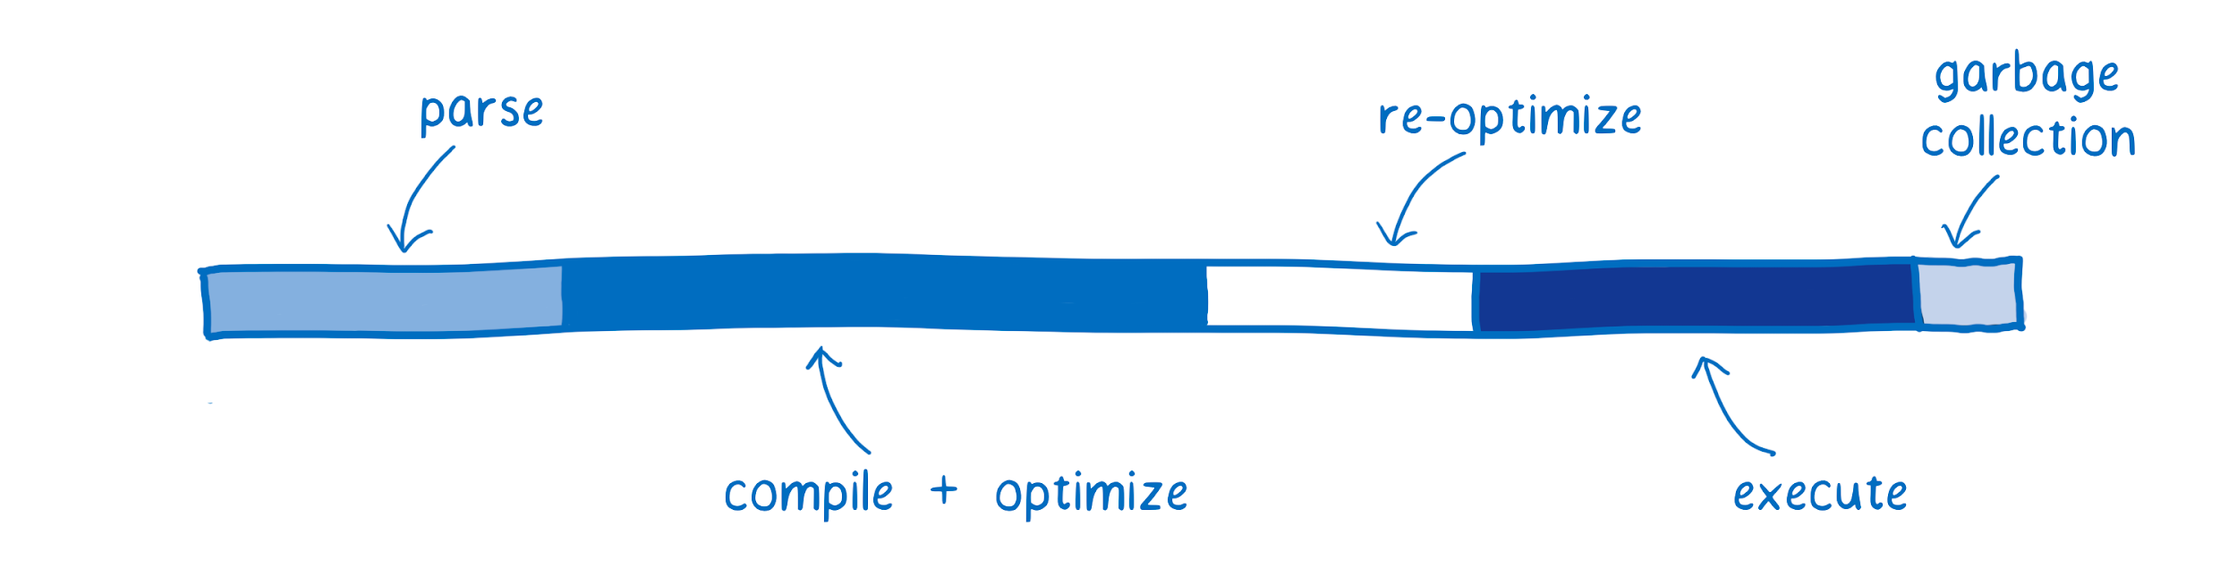
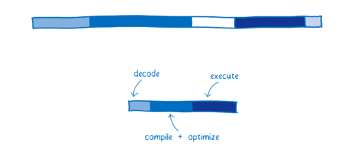
But wasm is faster
https://hacks.mozilla.org/2017/02/what-makes-webassembly-fast/
Wasm is compiled
No type assertion
No need to re-optimize
Much less GC
Notes:
Near machine code performance

Slide 11
From WebAssembly to JS engine
https://mbebenita.github.io/WasmExplorer/
.go
.wasm (IR)
Firefox x86 Assembly
spider monkey
Chart Data Source Info

Slide 12
Some Examples
“Unleash the power of your web devices”

Slide 13
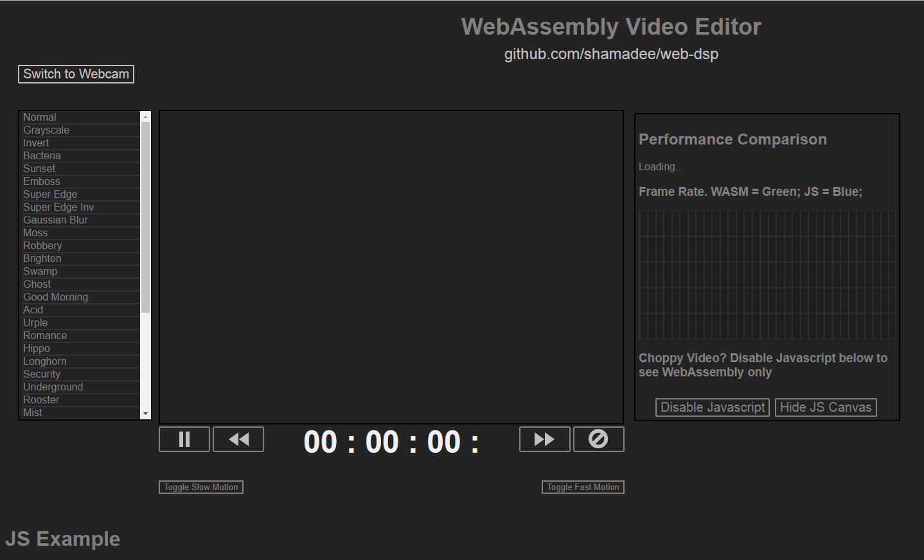
Wasm vs JS
github.com/shamadee/web-dsp https://d2jta7o2zej4pf.cloudfront.net/

Slide 14

Epic Epic Zen Garden
Unreal Engine in WebAssembly and WebGL 2.0
https://s3.amazonaws.com/mozilla-games/ZenGarden/EpicZenGarden.html

Slide 15
Go WebAssembly
From Go to web

Slide 16

Go-WebAssembly
go 1.11 (Aug. 2018)
Experimental feature
https://github.com/golang/go/wiki/WebAssembly
Notes:
Runs in javascript engines

Slide 17
1.11 Release Note
Go 1.11 adds an experimental port to WebAssembly (js/wasm). Go programs compile to one WebAssembly module
Go runtime for goroutine scheduling, garbage collection, maps, etc. Go programs can call into JavaScript using the new experimental syscall/js package. new GOOS "js" and GOARCH "wasm"

Slide 18
Why Go-WebAssembly
Again, why?

Slide 19
Go-WebAssembly
Runs existing program / library in Front-End
Make golang protable
Thread Safe
Back-End to Full-Stack?
Notes:
Go

Slide 20
Let’s Go-WebAssembly

Slide 21
<html> <head> <meta charset="utf-8"> <script src="wasm_exec.js"></script>
<script> const go = new Go(); WebAssembly.instantiateStreaming( fetch("main.wasm"), go.importObject) .then((result) => { go.run(result.instance); }); </script>
</head> <body></body> </html>
Notes:
The WebAssembly.instantiateStreaming() function compiles and instantiates a WebAssembly module directly from a streamed underlying source. This is the most efficient, optimized way to load wasm code.

Slide 22
run-%: GOOS=js GOARCH=wasm go run -exec="$(shell go env GOROOT)/misc/wasm/go_js_wasm_exec" ./src/$* test: GOOS=js GOARCH=wasm go test -exec="$(shell go env GOROOT)/misc/wasm/go_js_wasm_exec" ./... build-%: GOOS=js GOARCH=wasm go build -o public/lib.wasm ./src/$* server: go run ./src/server -listen :8080 -dir public

Slide 23
From Golang to Web
Compile golang functions to wasm, and runs in JS
.go
.wasm
JS API
Engine
Chart Data Source Info

Slide 24
package main import ( "strconv" "syscall/js" )
func add(i []js.Value) {
doc := js.Global().Get("document") value1 := doc.Call("getElementById", "input1").Get("value").String() value2 := doc.Call("getElementById", "input2").Get("value").String() int1, _ := strconv.Atoi(value1) int2, _ := strconv.Atoi(value2) doc.Call("getElementById", "sum").Set("value", int1+int2) }

Slide 25
// JS
func add() { var value1 = document.getElementById("input1").value; vat value2 = document.getElementById("input2").value; document.getElementById("sum").value = Number(value1) + Number(value2); }
// Go
func add(i []js.Value) {
doc := js.Global().Get("document") value1 := doc.Call("getElementById", "input1").Get("value").String() value2 := doc.Call("getElementById", "input2").Get("value").String() int1, _ := strconv.Atoi(value1) int2, _ := strconv.Atoi(value2) doc.Call("getElementById", "sum").Set("value", int1+int2) }

Slide 26

Pacakge syscall/js
Bumpy when manipulate DOM
access WebAssembly host environment using the js/wasm architecture
API is based on JavaScript semantics.
EXPERIMENTAL
Notes:
Go

Slide 27
func main() { c := make(chan struct{}, 0) println("WASM Go Initialized")
// register functions registerCallbacks() <-c
println("Callbacks registered.") // console.log }
func registerCallbacks() { js.Global().Set("add", js.NewCallback(add)) js.Global().Set("subtract", js.NewCallback(subtract)) }

Slide 28

Use Go as Modules
Import Go packages
Complie to .wasm
Register functions as JS callbacks
Invoke functions in JS
Leave the DOMs to JS

Slide 29
Benefits from Go-wasm
Runs existing program / library in Front-End
Make golang protable
Thread Safe
Join .wasm from other languages

Slide 30
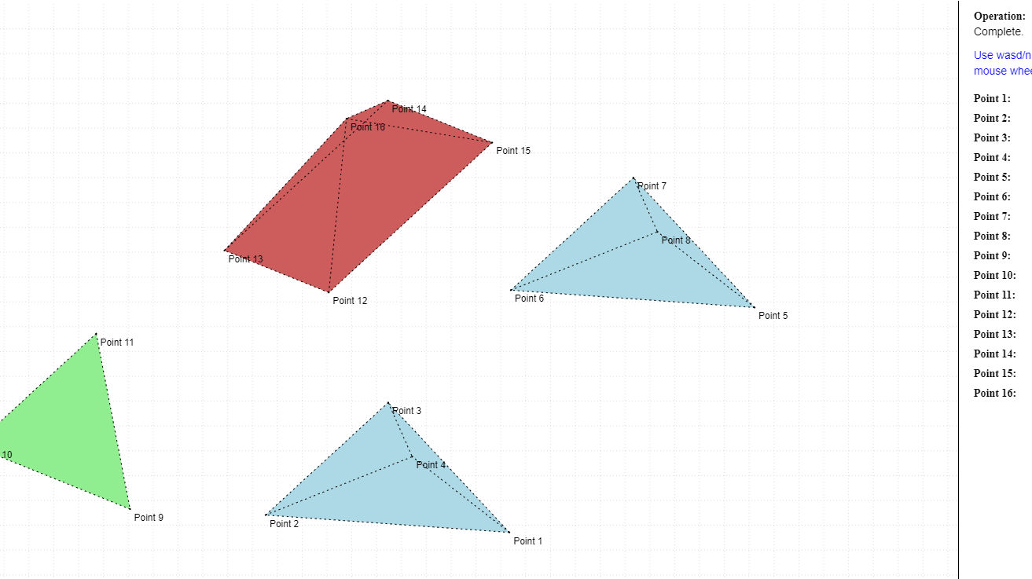
Go-Wasm Examples
https://justinclift.github.io/wasmGraph1/

Slide 31

GameBoyColor-Wasm
https://github.com/djhworld/gomeboycolor-wasm

Slide 32
Move Back-End Front
Performance no longer a problem. What you want to run in browser?
kubernetes, kubectl, geth...

Slide 33
Lin Clark: A Cartoon Intro to WebAssembly | JSConf EU 2017 https://www.youtube.com/watch?v=HktWin_LPf4
https://hacks.mozilla.org/2017/02/a-cartoon-intro-to-webassembly/
Dan Callahan: Practical WebAssembly | JSConf Budapest 2017
https://www.youtube.com/watch?v=bac0dGQbUto
Using WebAssembly and Threads (Chrome Dev Summit 2018)
https://www.youtube.com/watch?v=zgOGZgAPUjQ
Watch Lin Clark cartoon if you only have 30 mins!

Slide 34
Q&A

